Slide 1
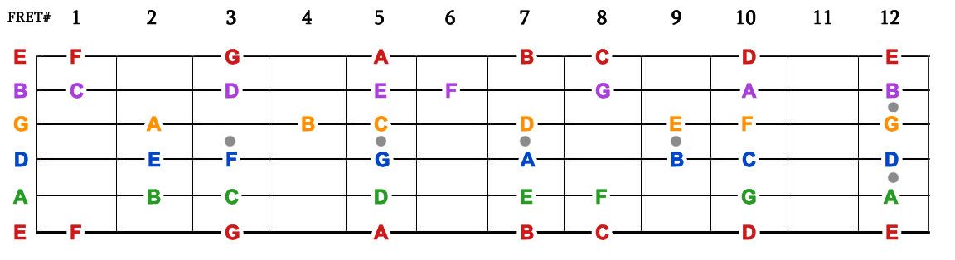
NOTES IN THE GUITAR FRETBOARD

Slide 2
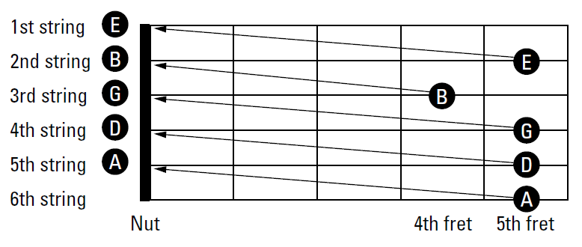
GUITAR STANDARD TUNING
E

Slide 3
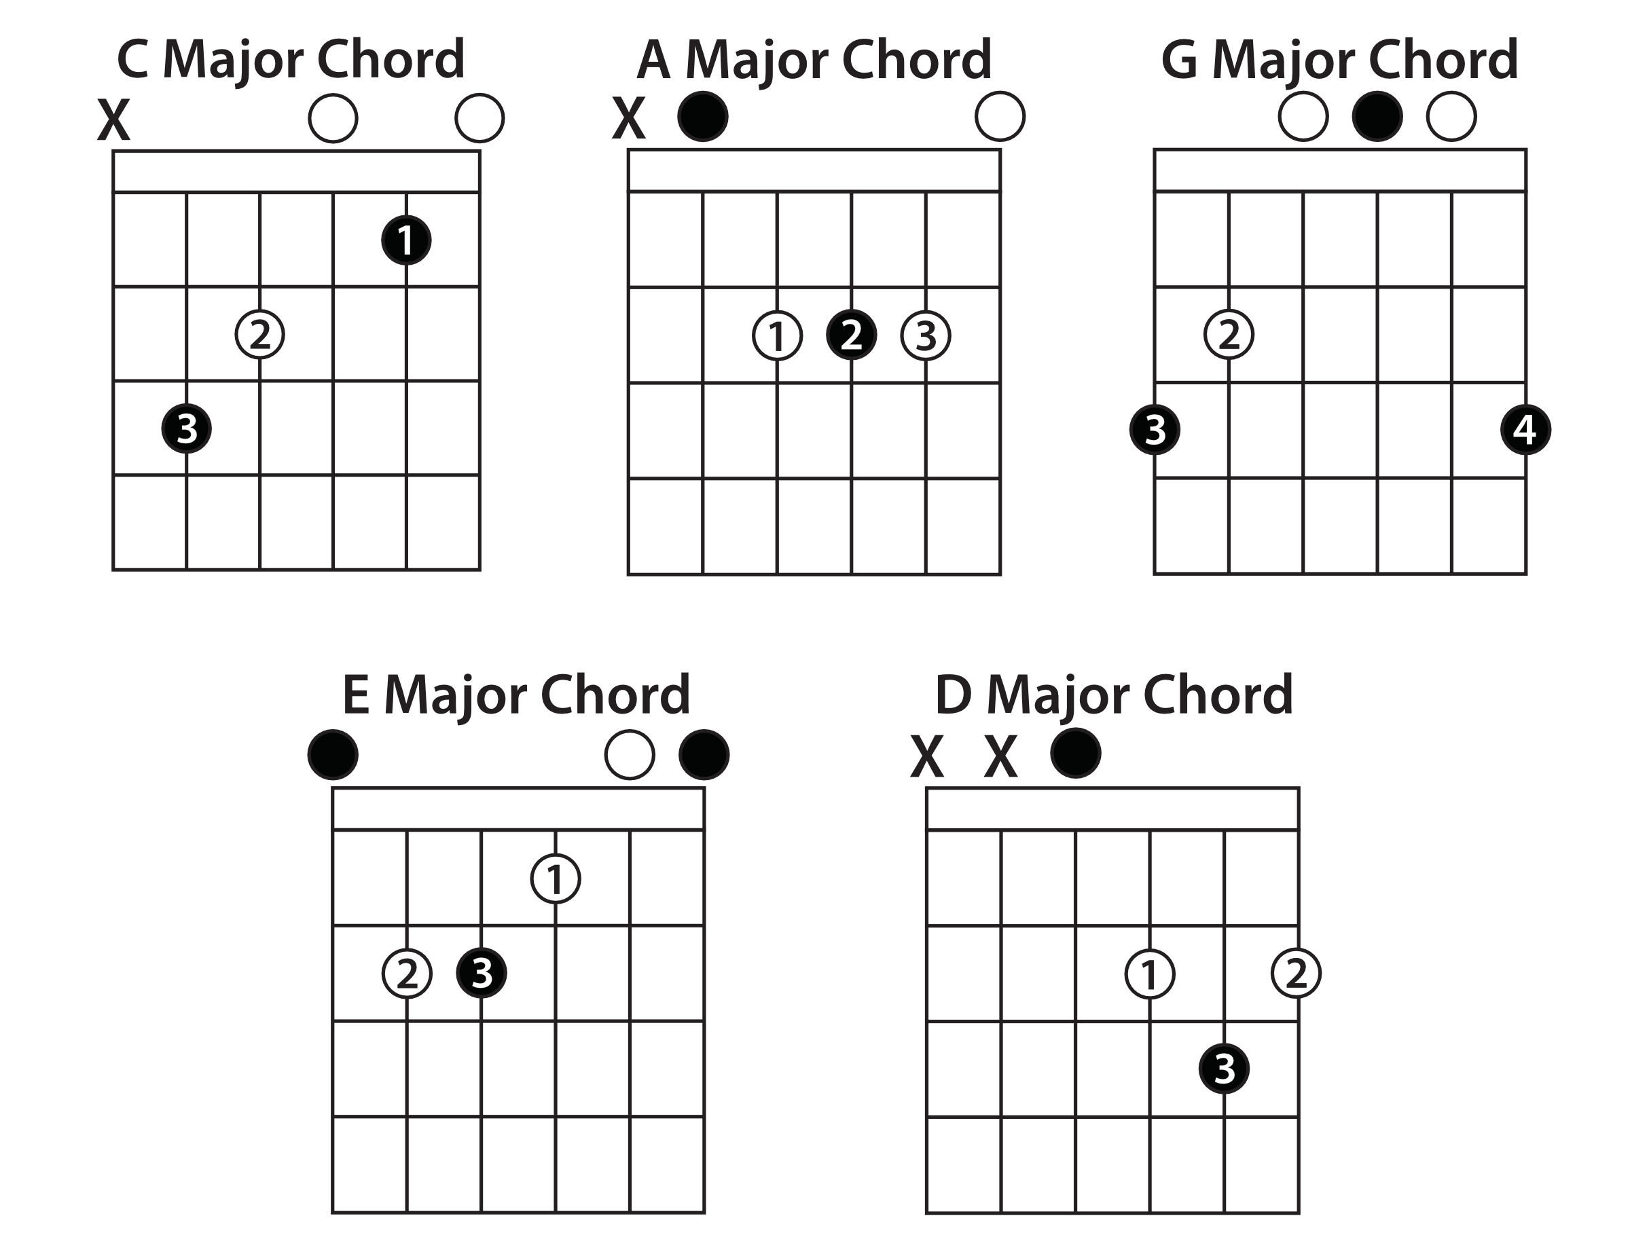
THE CAGED CHORDS

